Slide 1
Introduction of Lambda's

Slide 2
Why Were Lambdas Introduced?
The Problem Before Java 8
Creating anonymous inner classes for Callbacks, Event listeners, and Comparators made code:
Verbose: More words than necessary.
Hard to Read: Difficult to follow the logic.
Cumbersome: Complicated and unwieldy.
The Solution: Lambdas
Lambdas were introduced to simplify and shorten this code, making it more readable and less cumbersome.

Slide 3
Why Lambdas are Better
Removes Boilerplate: Eliminates verbose anonymous inner class syntax.
Concise Code: Shorter, more expressive, and focuses on the logic.
Functional Style: Enables functional programming and works with Streams.
Safer Closures: Clearly captures `final` or `effectively-final` variables.
Readability: Much easier to read and maintain once you understand the syntax.

Slide 4
Use Case 1: What is a callback?
Definition
A callback is a method (a piece of code) that is passed as an argument to another method. The receiving method then "calls back" this method later, often when a task is finished or an event occurs.
Common Uses
Handling button clicks, completing an asynchronous task (like downloading data), or executing code in a separate thread.

Slide 5
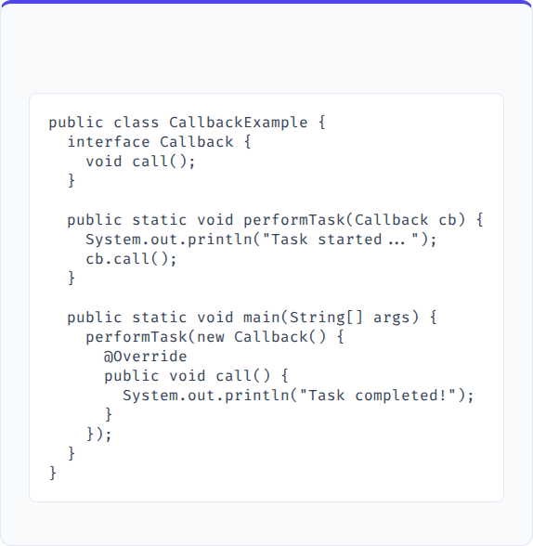
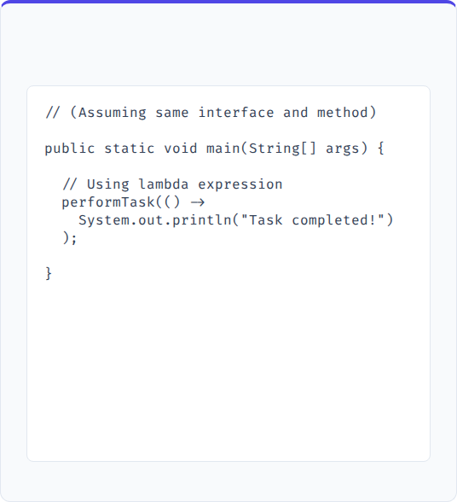
Callbacks: Code Comparison
Before Java 8
After Java 8

Slide 6
Use Case 2: What is an event listener?
Definition
An Event Listener is an object that waits for an event to occur (like a button click, mouse move, key press, etc.) and executes specific code in response to that event.
In Simple Words
Event Listener = “When this happens, do this.”

Slide 7
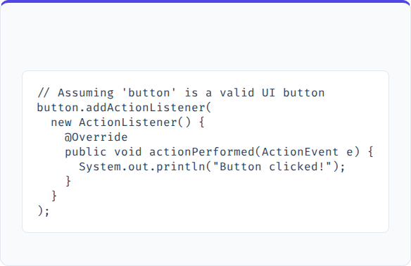
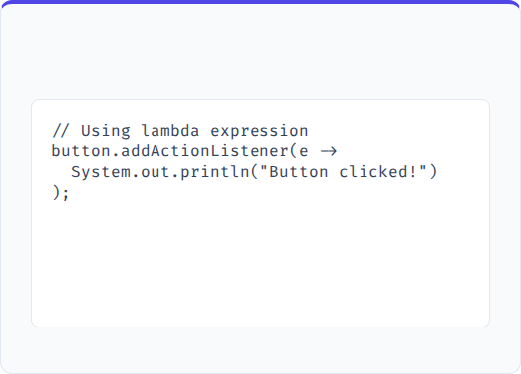
Event Listeners: Code Comparison
Before Java 8
After Java 8

Slide 8
Use Case 3: What is a comparator?
Definition
A Comparator is an interface in Java used to define custom sorting logic for objects.
Simple Definition
👉 Comparator = a rule that tells Java how to compare two objects.
Why we use it
To sort objects in a specific order (ascending, descending, by name, by age, etc.)

Slide 9
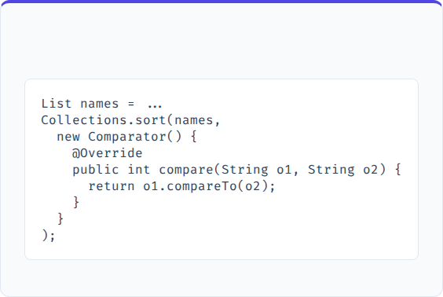
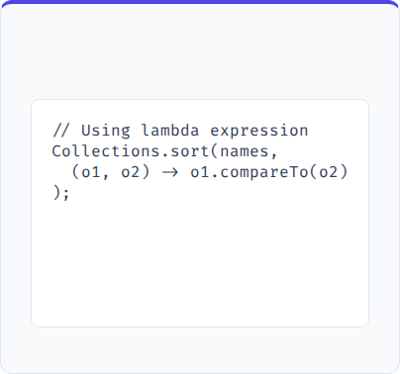
Comparators: Code Comparison
Before Java 8
After Java 8

Slide 10
Use Case 4: What is a runnable?
Definition
A Runnable is a functional interface in Java that represents a task or piece of work that can be executed by a thread.
Simple Definition
👉 Runnable = a task that a thread can run.
Key Point
It has only one method: void run();

Slide 11
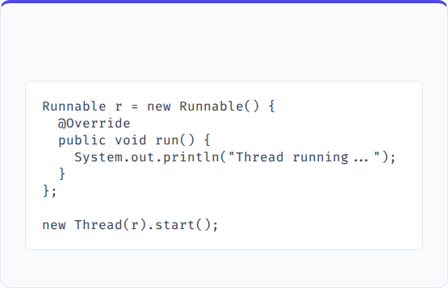
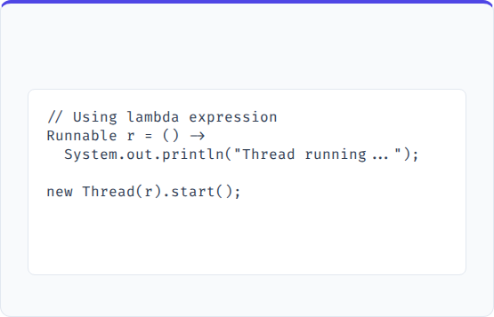
Runnable: Code Comparison
Before Java 8
After Java 8

Slide 12
Questions?
Thank you for your attention,
If you have any questions, please comment on the comment session I will reply on comments.

